Slide 1
UNIT 2
THE MOLECULAR DESIGN OF LIFE

Slide 2
BIODIVERSITY CHEMICAL BOND BIOLOGICAL MACROMOLECULES DNA RNA GENE EXPRESSION DNA REPLICATION TRANSCRIPTION TRANSLATION STEM CELLS RECOMBINANT DNA TECHNOLOGY

Slide 3
Introduction
A group of living organisms consisting of similar individuals capable of exchanging genes or interbreeding are called as species
An ecosystem is a geographic area where plants, animals, and other organisms, as well as weather and landscape, work together to form a life

Slide 4
BIODIVERSITY
Biodiversity is defined as the occurrence of different types of ecosystem, different species of organisms with the whole range of their variants and genes adapted to different environments along with their processes and interactions.
The term biodiversity was coined by W. G. Rosen in 1985 whereas Edward Wilson in1992.
According to the IUCN in 2004 report globally total number of known plants and animals species are more than 1.5 million.
India is one of the 12 mega diversity regions of the world. India shares
8.1% of total global species diversity.
Total numbers of known species in India are about 1, 42,000 in these approximately 45,000 plants and around twice as many as animals.

Slide 5
TYPES OF BIODIVERSITY
Diversity helps in producing more productive and stable ecosystems which can tolerate various stresses. Biodiversity has three inter-related hierarchical levels.
1) Genetic diversity : The diversity in the numbers and types of genes as well as chromosomes present in different species and the variations in the genes and their alleles in the same species. Eg. Different breeds of Dogs.
2) Species diversity: The variety in the number and richness of the species of a region. The number of the species per unit area is called species richness. A number of individuals of different species represent species evenness or species equitability. Eg.Aquatic species from blue whales to micro organism.

Slide 6
Cont.
3) Ecological diversity: It is the variety of forms in the ecosystem due to the diversity of richness of niches, trophic lands, energy flow, food web, etc.,

Slide 7
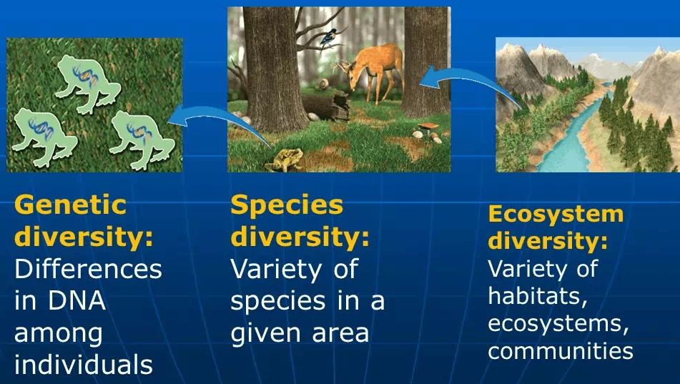

Slide 8
IMPORTANCE OF BIODIVERSITY
The maintenances of biodiversity are important because of the following reasons:
● Biodiversity is essential for the stability of an ecosystem.
● Biodiversity serves as a source of food and provides source materials for the new improved varieties.
● Various products of human use can be obtained from rich biodiversity. E.g. gums, resins,dyes, paper, fibers, etc.
● Various plant species provide different drugs and medicines. E.g. quinine
● Different animal species are used for biological and medical research.

Slide 9
Biodiversity in the ecosystem provides services for human welfare without these we cannot survive.
These include;
♦ Soil fertility,
♦ Pollinators of plants,
♦ Predators,
♦ Decomposition of wastes,
♦ Purification of the air and water,
♦ Stabilization and moderation of the climate,
♦ Decreasing floods, droughts, and other environmental disasters.

Slide 10
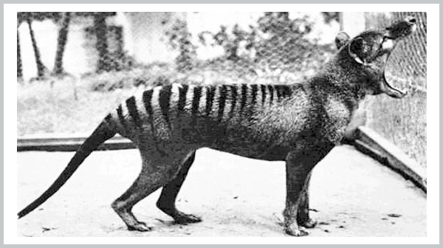
LOSS OF BIODIVERSITY
The most serious aspect of the loss of biodiversity is the extinction of species.
Extinction is of three types they are
Natural extinction-
Natural extinction is a slow process of replacement due to alternate evolution, changes in environmental conditions, predators and diseases
Eg: 1936 Tasmanian wolf -- extinct from hunting, habitat loss, and competition with dogs

Slide 11
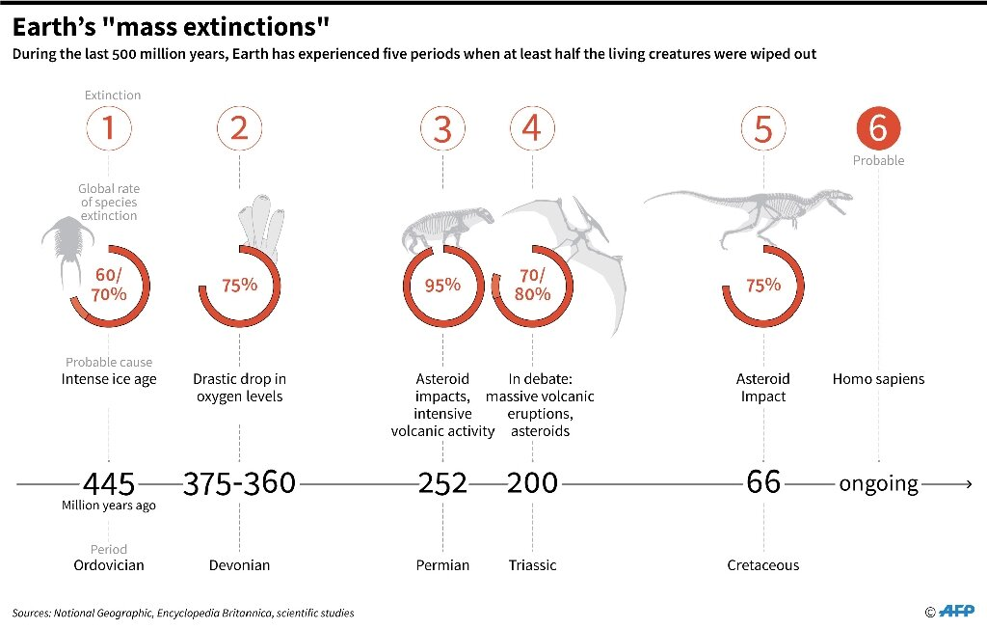
Cont.
II. Mass extinction –
Mass extinction is due to environmental catastrophes (disaster)
eg: Dinosaurs extinction

Slide 12
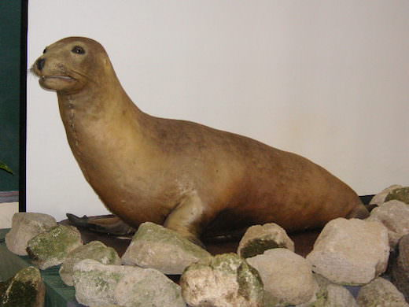
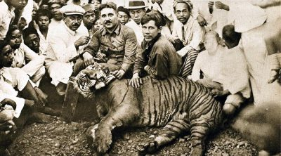
III. Anthropogenic extinction-
Anthropogenic extinctions are extinctions abetted by human activities like settlements, hunting, over-exploitation and habitat destruction
eg: Japanese sea lion; javan tiger

Slide 13
CHEMICAL BOND
A number of atoms are assembled and held together to form thousands of molecules which participate in the building and function of the physical and biological systems.
A bond is any force which linked two atoms together. The formation of the bond between two atoms.
which are divided into three major forms of bonds:
Electrovalent or Ionic bond
Covalent and
Coordinate bond.

Slide 14
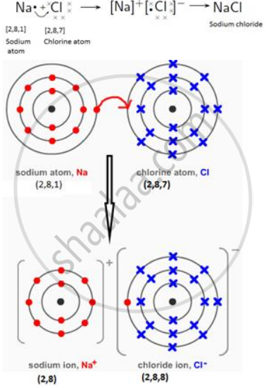
Electrovalent or Ionic bond
The ionic bond formation can occur between two atoms of strongly electropositive and strongly electronegative elements.
The compound formed by electron transfer is termed as “electrovalent”.
Electrovalent linkage is common in inorganic compounds (NaCl, Na 2 O, etc).
For example; NaCl

Slide 15
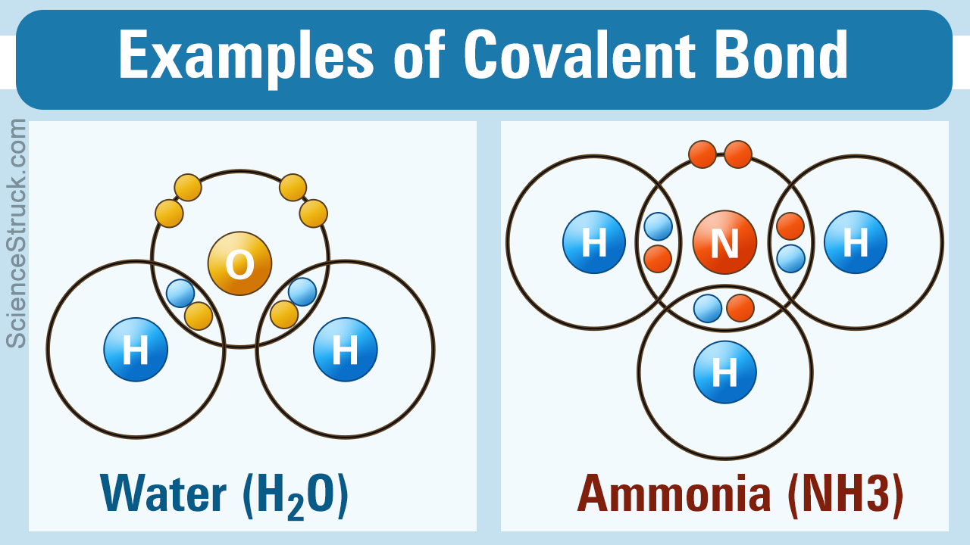
NON-POLAR or COVALENT BOND
Sharing of one or more pairs of electrons between two atoms formed covalent bond.
This type of bond linkage which is the result of equal contribution and equal sharing of electrons is called a covalent bond.
These are soluble in organic solvents such as benzene, ether, pyridine, etc., and have low boiling and melting points because of the weaker nature of the bond.
● They are usually liquids or gases and are generally soft, volatile and easily fusible and volatile.
Covalent linkage is common in organic compounds.

Slide 16
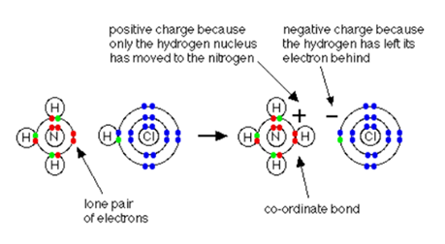
COORDINATE or DATIVE BOND
The coordinate bond is formed by mutual sharing of electrons, i.e. the two electrons that are shared attracts from the same atom.
The shared pair of electrons is known as the lone pair.
The atoms which give the pair of electrons is called the donor and the atom accepting or gaining this pair is called the acceptor.
Coordinate bonds are less common in organic compounds. However, they are commonly
found in complex molecules.
The two important biological compounds have the coordinate-covalent bond are chlorophyll and heme.

Slide 17
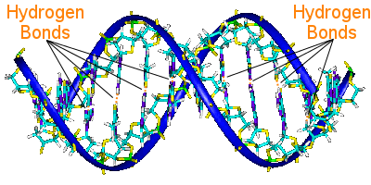
Hydrogen bond
Hydrogen bond can be formed between uncharged as well as charged ones.
In a hydrogen bond, a hydrogen atom is shared by two other atoms. Hydrogen bonds in biomolecules are also more specific than other weak bonds because they require particular complementary groups that donate or accept hydrogen.
Hydrogen bonding, both intramolecular (within a molecule) and an intermolecular (between two molecules), is common to many biological molecules such as proteins and DNA molecules.

Slide 18
Hydrophilic (or) hydrophobic bond
In macromolecules such as proteins, the acceptance or rejection by the aqueous environment of the hydrophilic (water-loving) and hydrophobic (water-fearing) components.
Many amino acids (alanine, valine, leucine, isoleucine, methionine) have the side chains or R-group which are essentially hydrophobic and phospho lipid bilayer of cell membrane.
Eg: Enzyme-substrate complex and Antibody-antigen interactions.
Van der Waals interactions (vdW)
A Van der Waals interaction is long-range attractions and repulsion between chemical species.
It is present even when there is no chemical bond
Van der Waals is relatively much weaker in strength than a normal chemical bond, but it is ubiquitous interaction, weaker and less specific than ionic and hydrogen bonds,
van der Waals interactions are no less important in biological systems. eg.Geckos hanging on sheer surface.

Slide 19
BIOLOGICAL MACROMOLECULES
Biomolecules may be defined as an organic compound normally present as an essential component of all living organisms.
All of the solid matter in the cell is organic and is present in four forms they are proteins, nucleic acids, polysaccharides (carbohydrates) and lipids.
Biological molecules are also called as macromolecules which have polymers of high molecular mass. They are,
Carbohydrate
Proteins
Lipids
Nucleic acid

Slide 20
CARBOHYDRATES
Carbohydrates are broadly present in plants and animals they have very important structural and metabolic roles in the cell.
In a plant cell, glucose is synthesized from carbon dioxide and water in the way of photosynthesis and stored as starch or used to the formation of the cellulose.
In animal, the cell can produce carbohydrate from lipid glycerol and amino acids, but most of the animal carbohydrates are derived from plants.
CLASSIFICATION
Monosaccharides: Monosaccharides are otherwise known as simple sugar
(that cannot be hydrolyzed into simpler carbohydrates). eg.Aldose sugar (Glucose) and Keto sugar (Fructose)

Slide 21
Disaccharides : Disaccharides are condensation products of two monosaccharide units. Examples are sucrose (Glucose +fructose) and maltose (glucose + glucose)
Oligosaccharides :Oligosaccharides (oligo means in Greek – few) are condensation products of two to ten monosaccharides units joined by characteristics linkages called glycosidic bonds. One of the examples is a maltotriose (three glucose molecule).
Polysaccharides Polysaccharides (also known as glycanes or poly sides) are condensation products may have hundreds or thousands of monosaccharides units.
They serve as both storage (starch, glycogen, inulin) and structural (cellulose, pectin, chitin) form of polysaccharides

Slide 22
PROTEIN
Proteins are macromolecules of high molecular mass, between several thousand and several million, consisting of chains of amino acids.
There are twenty different amino acids which are commonly found in naturally occurring proteins.
Proteins are made up of amino acids and therefore always contain the elements like carbon, oxygen, hydrogen, and nitrogen and in some occasions sulfur.
There is an essential component of the diet of animals and may be converted to both fat and carbohydrate by the cells.
Their diversity enables them to display a great range of structural and metabolic activities within the organism the proteins are a secondary structure (little or no tertiary structure)

Slide 23
TYPES OF PROTEINS
Fibrous proteins
Fibrous proteins are a secondary structure, insoluble in water, physically tough, long parallel polypeptide chains cross-linked at intervals forming long fibers or sheets. These are mainly of animal origin.
Functions
Fibrous proteins perform structural functions or protective role in cells and organisms examples, collagen (tendons, bone, connective tissue), myosin (in muscle), silk (spiders webs), keratin (hair, nails, feathers).
Globular proteins
Globular proteins are more complex than fibrous proteins, biological Globular proteins are mostly tertiary structure, polypeptide chains tightly folded to form spherical shape, easily soluble in nature.
Functions
Enzymes, antibodies, blood transport proteins, nutrient storage proteins, and some hormones

Slide 24
Conjugated proteins
Conjugated proteins are complex globular proteins and were tightly bound. These are the proteins are linked with non-protein part is called prosthetic group. Further classified based on the nature of the prosthetic group.
They are metalloproteins, glycoproteins, chromoproteins, lipoproteins, phosphoproteins, and nucleoproteins.
LIPIDS
The lipids form a heterogeneous class of compounds related to fatty acids and include fats, oils, waxes, steroids, and related compounds.
Phospholipids and sterols are major structural elements of biological membranes.
Other lipids although present in small quantities, plays a crucial role as enzyme cofactors, electron carriers, light-absorbing pigments, hydrophobic anchors, emulsifying agents, hormones and intercellular messengers.

Slide 25
CLASSIFICATION OF LIPIDS
Simple lipids or Homolipids :
These are esters of fatty acids with various alcohols.
The Fats and oils are stored form of energy in many organisms are derivatives of fatty acids.
Fats are stored in adipose tissue, where they also serve as a thermal
insulator in subcutaneous tissues and around nearby organs.
Triacylglycerols are fatty acid esters of glycerol. It is mainly defined as the
simplest lipids.
These are composed of three fatty acids are linked in ester bond
with single glycerol.
Waxes are esters of fatty acids. They can serve as a major storage form of metabolic fuels. Waxes are helped to protect hair and skin.

Slide 26
NUCLEIC ACIDS
Nucleic acids are polymers of nucleotides (nucleosides), which are made up of three major components, namely, a nitrogenous base, a pentose sugar (five-carbon sugar) and a phosphate molecule.
They are responsible for the storage and transfer of the information needed for the synthesis of polypeptides or proteins.
The two types of nucleic acids are DNA (Deoxyribonucleic acid) which is double-stranded, and RNA (Ribonucleic acid) which is single-stranded.

Slide 27
NITROGENOUS BASES
The nitrogenous bases are derivatives of 2 parent compounds namely, Pyrimidine and
Purine.
Purine bases
The DNA and RNA both are containing the purine bases. Purine ring bases are two namely:
a) Adenine: Chemically it is referred 6-aminopurine.
b) Guanine: Chemically it is referred 2-amino-6-oxy purine.
Pyrimidine Bases
Pyrimidine bases are found in nucleic acids which are mainly three.
A. Cytosine: Based on the structure it is “2-deoxy-4-amino pyrimidine”. This is found both in DNA and RNA.
B. Thymine: Chemically it is 2,4-deoxy-5Methyl Pyrimidine. This exists only in DNA.
C. Uracil: Chemically it is as 2,4-deoxy Pyrimidine, which can occur only in RNA.

Slide 28
DEOXY RIBO NUCLEIC ACID (DNA)
DNA (Deoxyribonucleic acid) is a molecule that is responsible for carrying and transmitting the hereditary materials or the genetic instructions from parents to offsprings and for the production of proteins.
DNA is found in both animal and plant cell in chromosomes, mitochondria, and chloroplasts.
DNA structure
The double helix structure of a DNA molecule was discovered by James Watson and Francis Crick.
The DNA structure is a long, double helix, which is twisted at both the ends. It is a nucleic acid and all nucleic acids are made up of nucleotides.

Slide 29
DNA Structure
The DNA molecule is composed of basic materials called nucleotides and each nucleotide is composed of three different components such as sugar, phosphate groups, and nitrogen bases.
The sugar and phosphate groups link the nucleotides together to form each strand of DNA.
The DNA molecule consists of four nitrogen bases namely adenine (A), thymine (T), Cytosine(C) and Guanine (G), which completely forms the structure of a nucleotide.
The A and G from a pair of purines and the C and T from pyrimidines
Among the three components of DNA structure, sugar is the one, which forms the backbone of the DNA molecule called deoxyribose.
The nitrogenous bases of the opposite strands form hydrogen bonds, forming a ladder-like structure.

Slide 30
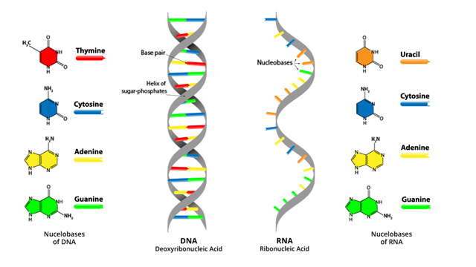
.
The two strands of DNA run in opposite directions
The two strands are held together by the hydrogen bond that is present between the two.
The strands are helically twisted, where each strand forms a right-handed coil and 10 nucleotides make up a single turn.
The pitch of each helix is 3.4 nm. Hence, the distance between two consecutive base pairs (i.e., hydrogen-bonded bases of the opposite strands) is 0.34 nm.

Slide 31
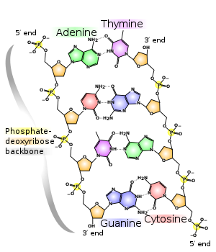
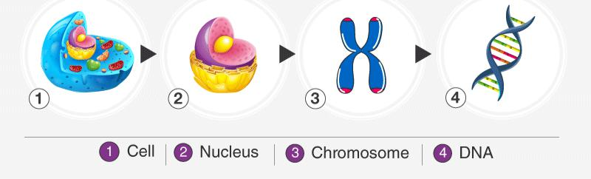
DNAs are coiled up forming chromosomes and each chromosome has a single molecule of DNA in it. Overall, human beings have around twenty-three pairs of chromosomes in them.
These chromosomes are found in the cells of the nucleus.
DNAs play an important role in the process of cell division.

Slide 32
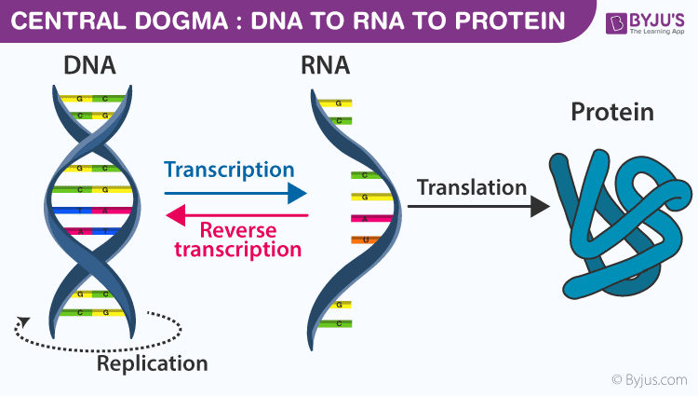
CENTRAL DOGMA
'Central Dogma' is the process by which the instructions in DNA are converted into a functional product.
It was first proposed in 1958 by Francis Crick, discoverer of the structure of DNA.
Replication, Transcription, and Translation are the three main processes used by all cells to maintain their genetic information and to convert the genetic information encoded in DNA into gene products, which are either RNAs or proteins, depending on the gene.

Slide 33
REPLICATION OF DNA
Replication is a process by which DNA molecules produce an identical copy of their own structure during cell division and the newly synthesized chains are complementary to the parental strands of the DNA.
DNA could theoretically replicate in three ways, namely, conservative, semiconservative and dispersive methods.
Conservative: Two helices formed, one was entirely old and the other entirely new one helix. In this method, the two strands of parent DNA were fully conserved.
Semiconservative: It was proposed by Watson and Crick, the two double helices formed have one old parental strand and one newly synthesized strand.
Dispersive: the DNA double helix would break at several points and then combine at random. Thus the double helices formed would have a patchwork of old and new pieces here and there.

Slide 34
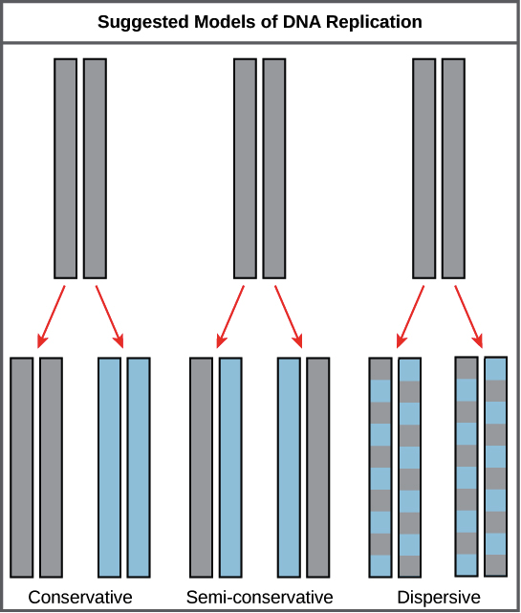

Slide 35
PROCESS OF REPLICATION
The synthesis process of DNA molecule occurs in three different steps. Initiating, Elongation and Termination.
Initiation:
Before DNA replicated, the double stranded molecule must be “unzipped” into two single strands.
DNA has four bases called adenine (A), thymine (T), cytosine (C) and guanine (G) that form pairs between the two strands.
Adenine only pairs with thymine and cytosine only binds with guanine.
In order to unwind DNA, these interactions between base pairs must be broken.
This is performed by an enzyme known as DNA helicase.
DNA helicase disrupts the Hydrogen bonding between base pairs to separate the strands into a Y shape known as the replication fork.
This area will be the template for replication to begin.

Slide 36
The directionality is important for replication as it only progresses in the 5' to 3' direction but the replication fork is bi-directional; one strand is 3' to 5' direction (leading strand) while the other is 5' to 3' (lagging strand).
The leading strand is the simplest to replicate.
Primers are generated by the enzyme DNA primase.
The primer always binds as the starting point for replication.
Once the DNA strands have been separated, a short piece of RNA called a primer binds to the 3' end of the strand.

Slide 37
Elongation
Enzymes known as DNA polymerases are responsible creating the new strand by a process called elongation.
polymerase III is the main replication enzyme, while polymerase I, II, IV and V are responsible for error checking and repair.
Replication proceeds in the 5' to 3' direction on the leading strand, the newly formed strand is continuous.
The lagging strand begins replication by binding with multiple primers. Each primer is only several bases apart. DNA polymerase then adds pieces of DNA, called Okazaki fragments, to the strand between primers.
This process of replication is discontinuous as the newly created fragments are disjointed.

Slide 38
Termination
Once both the continuous and discontinuous strands are formed, an enzyme called exonuclease removes all RNA primers from the original strands.
These primers are then replaced with appropriate bases.
Another exonuclease “proofreads” the newly formed DNA to check, remove and replace any errors.
Another enzyme called DNA ligase joins Okazaki fragments together forming a single unified strand.
The ends of the parent strands consist of repeated DNA sequences called telomeres and they acts as protective caps

Slide 39
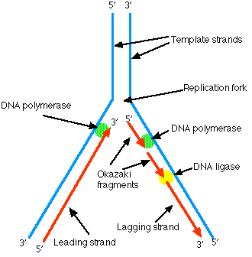
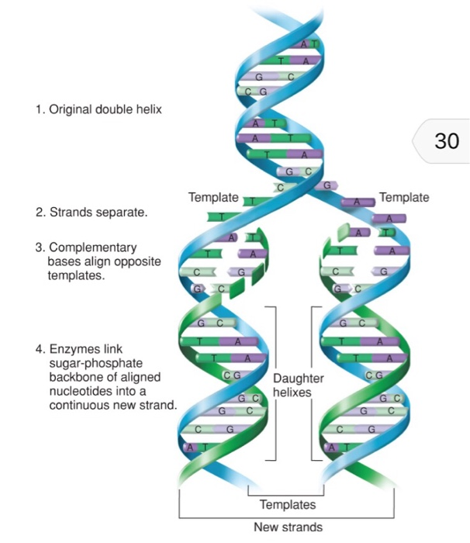

Slide 40
RIBONUCLEIC ACID (RNA)
RNA is a polyribonucleotide of Adenine, Guanine, Cytosine and Uracil linked together by 3’ – 5’ phosphodiester bonds.
RNA is found in the nucleolus, Nissel granules, mitochondria, and cytoplasm.
Types of RNA
mRNA- messenger RNA
tRNA- transfer RNA
rRNA- ribosomal RNA

Slide 41
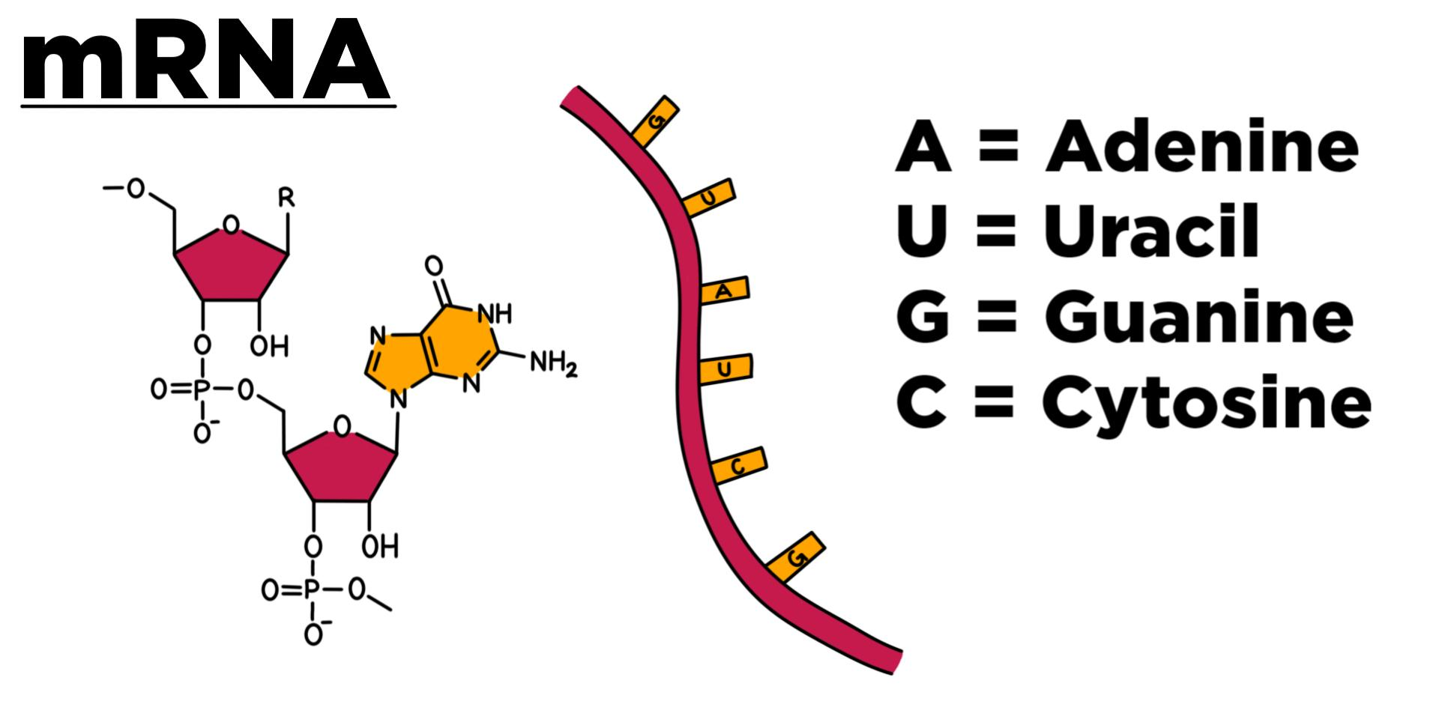
m-RNA molecules are formed with the help of DNA template (3’ – 5’) strand during the process of transcription.
m-RNA carries a specific sequence of nucleotides in triplets called as codons responsible for the synthesis of a specific protein molecule.
3’OH end of most m-RNA molecules carries polynucleotides or adenylate ribonucleotides consisting of 20 to 250 residues in length.
This is called poly A tail.

Slide 42
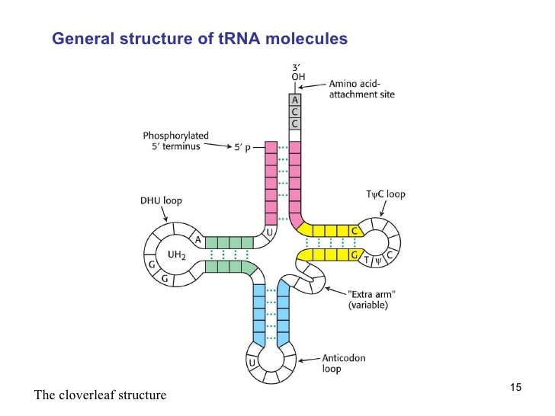
t-RNA –(transfer RNA)
t-RNA molecules consist of approximately 75 nucleotides.
Their bases include adenine, guanine, cytosine, uracil.
Each single-stranded t-RNA molecule remains folded to form a cloverleaf​ secondary structure.
tRNA molecule has a distinctive folded structure with three hairpin loops that form shape of a three-leafed clover.
One of these hairpin loops contains a sequence called the anticodon, which can recognize and decode an mRNA codon.
Each tRNA has its corresponding amino acid attached to its end.

Slide 43
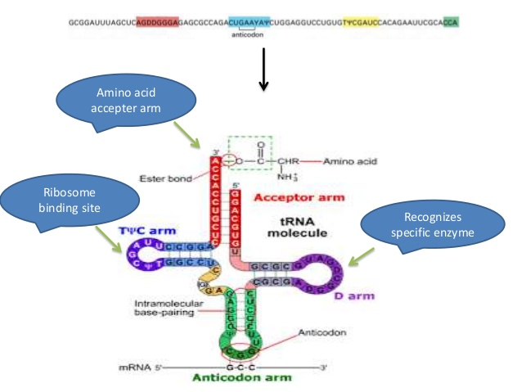
Ribosomal or r-RNA
rRNAs are found in the ribosomes and account for 80% of the total RNA present in the cell.
Ribosomal RNA (rRNA) associates with a set of proteins to form ribosomes.
These complex structures, which physically move along an mRNA molecule, catalyze the assembly of amino acids into protein chains.
They also bind tRNAs and various accessory molecules necessary for protein synthesis.

Slide 44
Genetic code
Genetic code may be defined as the exact sequence of DNA nucleotides (A, T, G, and C) read as three letter words or codons (AUG), that determines the sequence of amino acids in protein synthesis.
A codon is a triplet of bases (or nucleotides) in the DNA coding for one amino acid.
There are 64 codons, which correspond to 20 amino acids and it signals for the initiation and termination of transcription.
Each triplet [codon] specifies one amino acid in a protein structure or a start codon (AUG) or stop codon (UAA, UAG and UGA) in protein synthesis
The triplet of bases that is complementary to a codon is called an anti-codon; conventionally, the triplet in the mRNA is called the codon and the triplet in the tRNA is called the anti-codon.

Slide 45
DNA | RNA
Double helical strand and rarely single strand | Single strand and rarely double strand
In pentose sugar has deoxyribose which contains an H atom at C-2 | In pentose sugar have ribose which contains hydroxyl group
The nitrogenous bases are adenine, thymine, guanine, and cytosine | The nitrogenous bases are adenine, uracil, guanine, and cytosine
Base pairing is which A is pairs with T and G pairs with C | Base pairing takes place, A pairs with U and G pairs with C
Base pairing occupies the entire length of DNA molecule | Base pairing involves in only the helical region of an RNA molecule.
DNA is of three types: Double helical stranded, circular or single-stranded | RNA is of 5 types: mRNA, tRNA. rRNA, viral RNA, and double-stranded RNA
It consists of a larger number of nucleotide base pairs (around 3 – 4 million) and has, therefore, higher molecular weight | It consists of the fewer number of nucleotide (up to 12,000) and has, therefore, low molecular weight.

Slide 46
Thank You

